Slide 1
Omicron –new threat to pandemic
Dr. Sunil Kumar Mahavar
Professor
Dept. Of Internal Medicine
SMS Medical College Jaipur

Slide 7
The first sequenced omicron case was reported from Botswana on Nov 11, 2021. After initial identification that the new variant was associated with an S-gene target failure on a specific PCR assay because of a 69–70del deletion, similar to that observed with the alpha variant
Omicron has some deletions and more than 30 mutations, several of which (eg, 69–70del, T95I, G142D/143–145del, K417N, T478K, N501Y, N655Y, N679K, and P681H) overlap with those in the alpha, beta, gamma, or delta VoCs.
These deletions and mutations are known to lead to increased transmissibility, higher viral binding affinity, and higher antibody escape.
Some of the other omicron mutations with known effects confer increased transmissibility and affect binding affinity.
Notes:
Importantly, the effects of most of the remaining omicron mutations are not known, resulting in a high level of uncertainty about how the full combination of deletions and mutations will affect viral behaviour and susceptibility to natural and vaccine-mediated immunity.

Slide 8
previous VoCs emerged in a world in which natural immunity from COVID-19 infections was common, this fifth VoC has emerged at a time when vaccine immunity is increasing in the world.
The principal concerns about omicron include whether it is more infectious or severe than other VoCs and whether it can circumvent vaccine protection.
The emergence of the alpha, beta, and delta SARS-CoV-2 VoCs were associated with new waves of infections, sometimes across the entire world

Slide 9
The impact of omicron on transmissibility is a concern higher transmissibility is expected, particularly because of the mutations near the furin cleavage site.
it is not yet clear whether it has greater transmissibility than delta.

Slide 10
Covid-19: Runny nose, headache, and fatigue are commonest symptoms of omicron, early data show
Data released on 16 December by the Covid Symptoms Study, run by the health science company Zoe and King’s College London, show that the top five symptoms reported in the app for omicron infection were runny nose, headache, fatigue (either mild or severe), sneezing, and sore throat. This initial analysis was based on positive cases in London, which was selected because of its higher prevalence of omicron than in other parts of the UK.
The government still lists fever, cough, and loss of sense of smell or taste—which were the most common with the alpha variant—as the covid symptoms to watch out for.

Slide 12
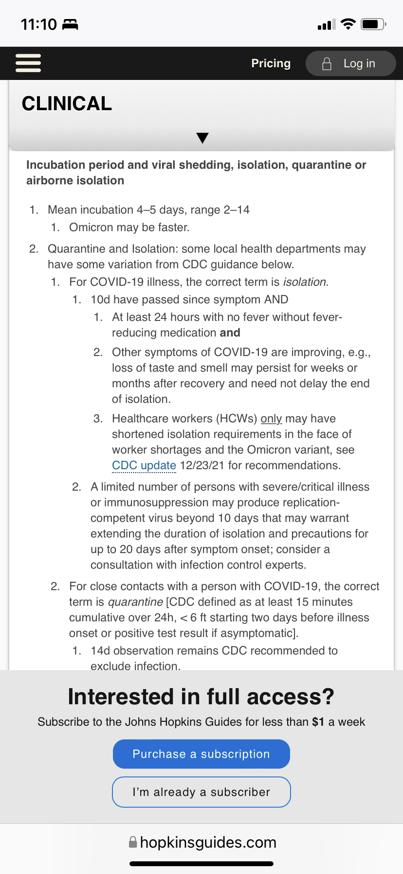

Slide 13
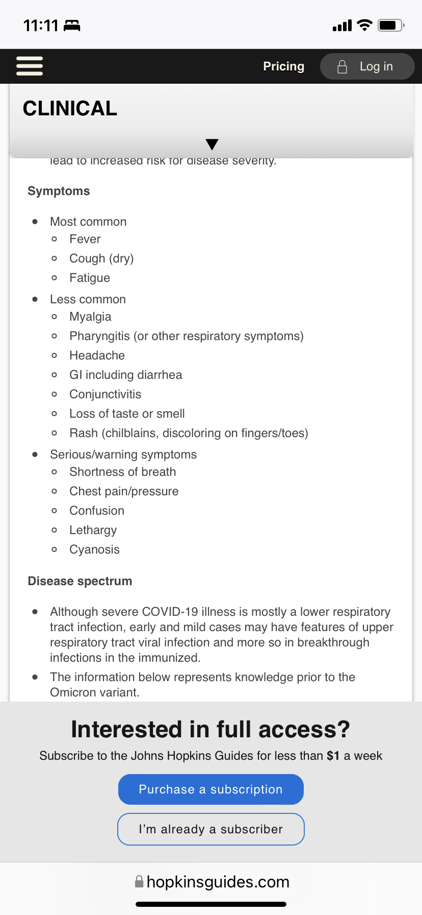

Slide 14
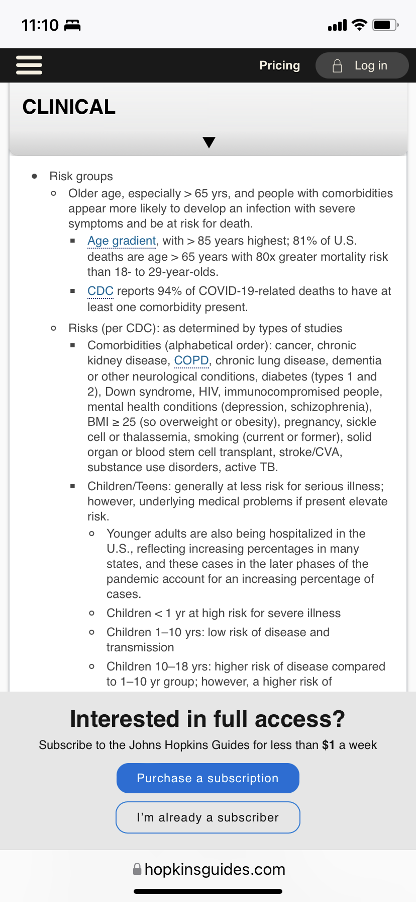

Slide 15
increased transmissibility
a higher viral load,
longer duration of infectiousness
and high rates of reinfection, because of its ability to escape from natural immunity,
VoC will impact clinical presentation ,At this stage patients with omicron are younger people with a clinical presentation similar to that of past variants.
Immune escape is another concern
the increase in cases of reinfection is in keeping with the immune-escape mutations present in omicron.

Slide 16
Prioritization of Patients at Highest Risk of Progression to Severe COVID-19
Risk Group1Immunocompromised individuals not expected to mount an adequate immune response to COVID-19 vaccination or SARS-CoV-2 infection due to their underlying conditions, regardless of vaccine status (see Immunocompromising Conditions below); or
Unvaccinated individuals at the highest risk of severe disease (anyone aged ≥75 years or anyone aged ≥65 years with additional risk factors).
2 Unvaccinated individuals at risk of severe disease not included in Tier 1 (anyone aged ≥65 years or anyone aged <65 years with clinical risk factors)
3 Vaccinated individuals at high risk of severe disease (anyone aged ≥75 years or anyone aged ≥65 years with clinical risk factors)

Slide 17
In terms of diagnostics, the omicron variant is detectable on widely used PCR platforms in South Africa.
There is no reason to believe that current COVID-19 treatment protocols and therapeutics would no longer be effective, with the possible exception of monoclonal antibodies.

Slide 18
FigureSARS-CoV-2 cases in first, second, third, and fourth waves, Gauteng Province of South Africa

Slide 19
Importantly, existing public health prevention measures (mask wearing, physical distancing, avoidance of enclosed spaces, outdoor preference, and hand hygiene) that have remained effective against past variants should be just as effective against the omicron variant.
omicron might spread faster and might escape antibodies more readily than previous variants, thereby increasing cases of reinfection and cases of mild breakthrough infections in people who are vaccinated.
On the basis of data from previous VoCs, people who are vaccinated are likely to have a much lower risk of severe disease from omicron infection .

Slide 20
Patient Prioritization for Pre-Exposure Prophylaxis
Tixagevimab plus cilgavimab (Evusheld) is authorized for use as SARS-CoV-2 PrEP for individuals who have moderate to severe immunocompromising conditions that may result in an inadequate immune response to COVID-19 vaccination.
Unlike anti-SARS-CoV-2 agents used for treatment, tixagevimab plus cilgavimab (Evusheld) is not authorized for use in unvaccinated individuals unless full vaccination is not possible due to a history of severe allergic reaction to the COVID-19 vaccine.
Generally speaking, those who qualify for PrEP because of allergy to the vaccine or contraindication to vaccination are less likely to suffer severe consequences, unless they are also moderately to severely immunocompromised.

Slide 21
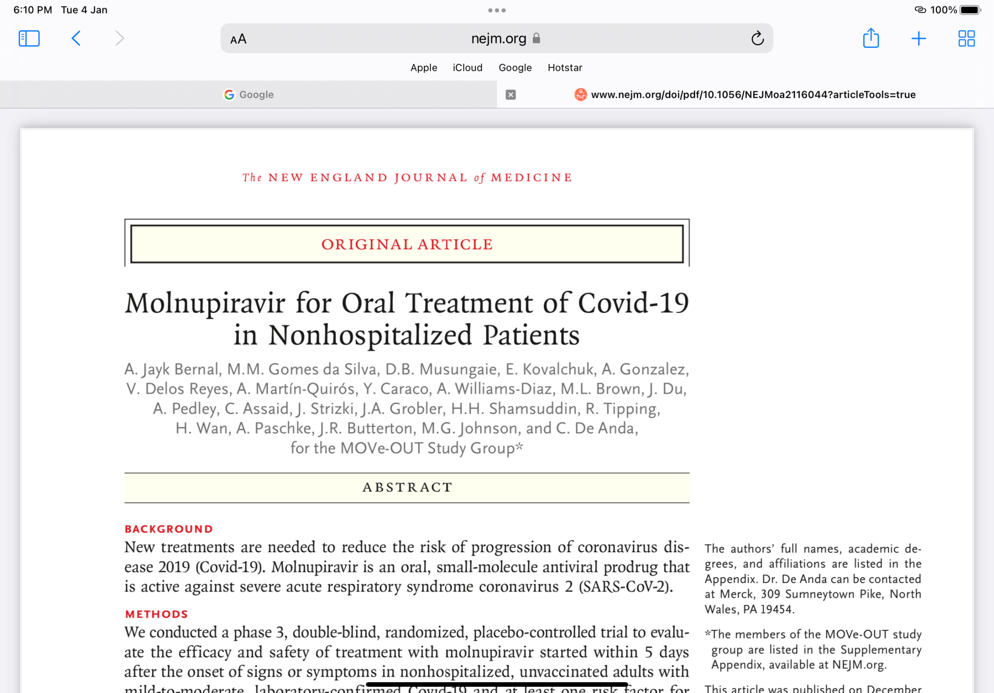

Slide 22
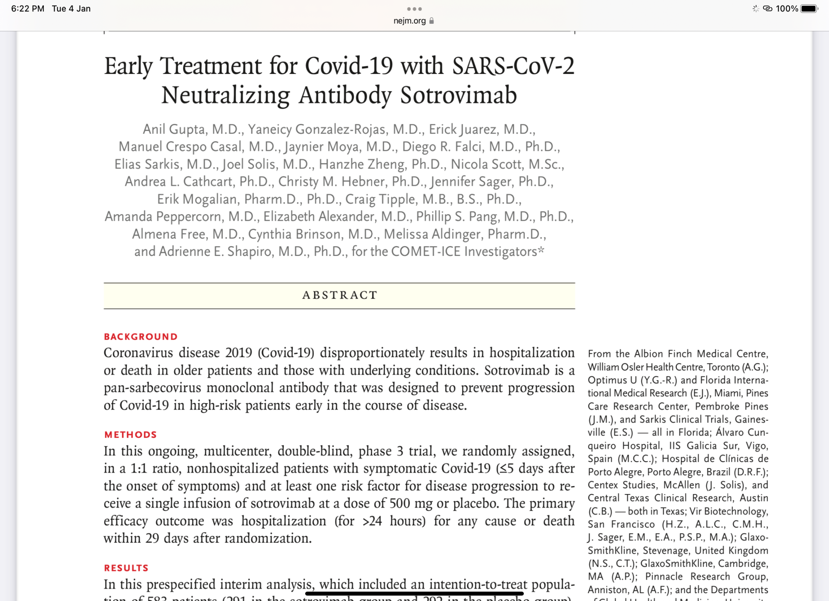

Slide 23
All these anti-SARS-CoV-2 therapeutics, which were evaluated initially in unvaccinated individuals, provide the greatest benefit for nonhospitalized patients who have risk factors for progression to severe COVID-19.
The risks for progression are substantially higher for those who are not vaccinated or those who are vaccinated but who are not expected to mount an adequate immune response to the vaccine.
When there are logistical or supply constraints that make it impossible to offer the available therapy to all eligible patients, patient triage will be necessary.

Slide 24
The COVID-19 Treatment Guidelines Panel's Statement on Therapies for High-Risk, Nonhospitalized Patients With Mild to Moderate COVID-19
On December 22 and 23, 2021, the Food and Drug Administration (FDA) issued Emergency Use Authorizations (EUAs) that allow 2 new oral antiviral agents to be used in this patient population:
ritonavir-boosted nirmatrelvir (Paxlovid)
molnupiravir

Slide 25
Ritonavir-Boosted Nirmatrelvir (Paxlovid)
Nirmatrelvir (PF-07321332) is an orally bioavailable protease inhibitor that is active against MPRO, a viral protease that plays an essential role in viral replication by cleaving the 2 viral polyproteins.
It has demonstrated antiviral activity against all coronaviruses that are known to infect humans.
Nirmatrelvir is packaged with ritonavir (as Paxlovid), a strong cytochrome P450 (CYP) 3A4 inhibitor and pharmacokinetic boosting agent. Ritonavir is required to increase nirmatrelvir concentrations to the target therapeutic ranges.

Slide 26
Nirmatrelvir 300 mg with ritonavir 100 mg (Paxlovid) orally twice daily for 5 days, initiated as soon as possible and within 5 days of symptom onset in those aged ≥12 years and weighing ≥40 kg (AIIa).
Before prescribing ritonavir-boosted nirmatrelvir (Paxlovid), clinicians should carefully review the patient’s concomitant medications, including over-the-counter medications and herbal supplements, to evaluate potential drug-drug interactions.
In the EPIC-HR trial, ritonavir-boosted nirmatrelvir (Paxlovid) reduced the risk of hospitalization or death by 88% compared to placebo in nonhospitalized adults with laboratory-confirmed SARS-CoV-2 infection.
This efficacy is comparable to the efficacies reported for sotrovimab (i.e., 85% relative reduction), and remdesivir (i.e., 87% relative reduction) and greater than the efficacy reported for molnupiravir (i.e., 30% relative reduction).

Slide 27
Sotrovimab
Sotrovimab 500 mg as a single IV infusion, administered as soon as possible and within 10 days of symptom onset in those aged ≥12 years and weighing ≥40 kg who live in areas with a high prevalence of the Omicron VOC (AIIa).
Sotrovimab should be administered in a setting where severe hypersensitivity reactions, such as anaphylaxis, can be managed. Patients should be monitored during the infusion and observed for at least 1 hour after infusion.
In the clinical trials for these agents, anti-SARS-CoV-2 mAbs reduced the risk of hospitalization or death by 70% to 85% compared to placebo.

Slide 28
Remdesivir
Remdesivir 200 mg IV on Day 1, followed by remdesivir 100 mg IV daily on Days 2 and 3, initiated as soon as possible and within 7 days of symptom onset in those aged ≥12 years and weighing ≥40 kg (BIIa).
Remdesivir is currently approved by the FDA for use in hospitalized individuals, and outpatient treatment would be an off-label indication.
Remdesivir should be administered in a setting where severe hypersensitivity reactions, such as anaphylaxis, can be managed. Patients should be monitored during the infusion and observed for at least 1 hour after infusion.
The PINETREE trial showed that 3 consecutive days of IV remdesivir resulted in an 87% relative reduction in the risk of hospitalization or death compared to placebo.

Slide 29
Molnupiravir
Molnupiravir is the oral prodrug of beta-D-N4-hydroxycytidine (NHC), a ribonucleoside that has broad antiviral activity against RNA viruses. NHC uptake by viral RNA-dependent RNA-polymerases results in viral mutations and lethal mutagenesis.
Molnupiravir has potent antiviral activity against SARS-CoV-2.4 As a mutagenic ribonucleoside antiviral agent, there is a theoretical risk that molnupiravir will be metabolized by the human host cell and incorporated into the host DNA, leading to mutations.
The FDA concluded that, based on the available genotoxicity data and the 5-day duration of treatment, molnupiravir has a low risk for genotoxicity.
In the MOVe-OUT trial, molnupiravir reduced the rate of hospitalization or death by 30% compared to placebo.

Slide 30
Molnupiravir
Molnupiravir 800 mg orally twice daily for 5 days, initiated as soon as possible and within 5 days of symptom onset in those aged ≥18 years ONLY when none of the above options can be used (CIIa).
The FDA EUA states that molnupiravir is not recommended for use in pregnant patients due to concerns about the instances of fetal toxicity observed during animal studies.
The prescribing clinician should document that a discussion of the risks and benefits occurred and that the patient chose this therapy.
There are no data on the use of molnupiravir in patients who have received COVID-19 vaccines, and the risk-to-benefit ratio is likely to be less favorable because of the lower efficacy of this drug.

Slide 31
Has omicron increased the need for boosters?
omicron significantly reduced the effectiveness of vaccines against symptomatic infection, when compared with the previously dominant delta infection.
in South Africa, where omicron was first detected. A very small study, released as a preprint and involving just 12 people in South Africa, indicated that concentrations of neutralising antibodies after the Pfizer vaccine were 41-fold lower in the presence of omicron.
These findings have been supported by the latest report (11 December) from the UK’s Com-COV2 study, which found a “substantial fall in neutralisation titres” with the omicron variant in people who had had two doses of the Pfizer or AstraZeneca vaccines.
It is estimated that 44% of people in the world have not had a single dose of a covid vaccine and that only 7.1% of people in low income countries have received at least one dose.

Slide 32
HOME ISOLATION & CARE FOR COVID-19 (Revised on 05/01/2022)
Asymptomatic contacts to home quarantine for 7 days
Symptomatic individuals will end home isolation after at least 7 days have passed since testing positive and afebrile for 3 consecutive days.

